Slide 1
Parameter Quantization
Dr. Yan Yan

Slide 2
Parameter Quantization
1. Using less bits to represent a value
2. Weight clustering
0.5 | 1.3 | 4.3 | -0.1
0.1 | -0.2 | -1.2 | 0.3
1.0 | 3.0 | -0.4 | 0.1
-0.5 | -0.1 | -3.4 | -5.0
weights in
a network
Clustering

Slide 3
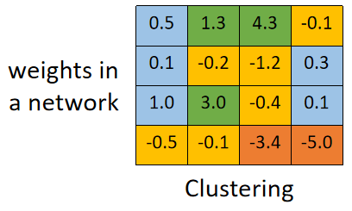
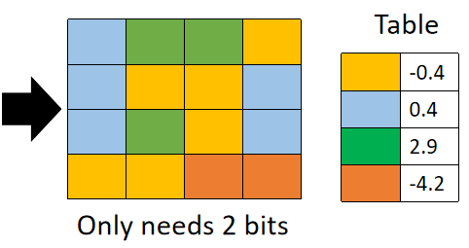
Parameter Quantization
1. Using less bits to represent a value
2. Weight clustering
3. Represent frequent clusters by less bits, represent rare clusters by more bits
e.g. Huffman encoding

Slide 4
Binary Weights
Binary Connect
Your weights are always +1 or -1
network with binary weights
network with real value weights
Negative gradient
(compute on binary weights)
Update direction
(compute on real weights)
https://arxiv.org/abs/1602.02830

Slide 5
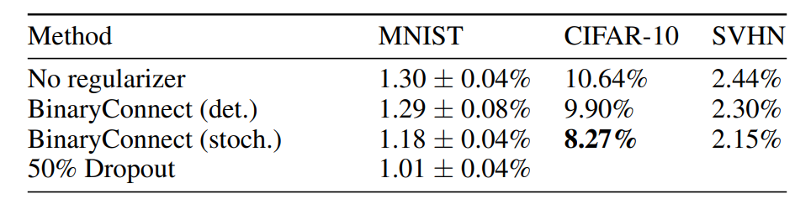
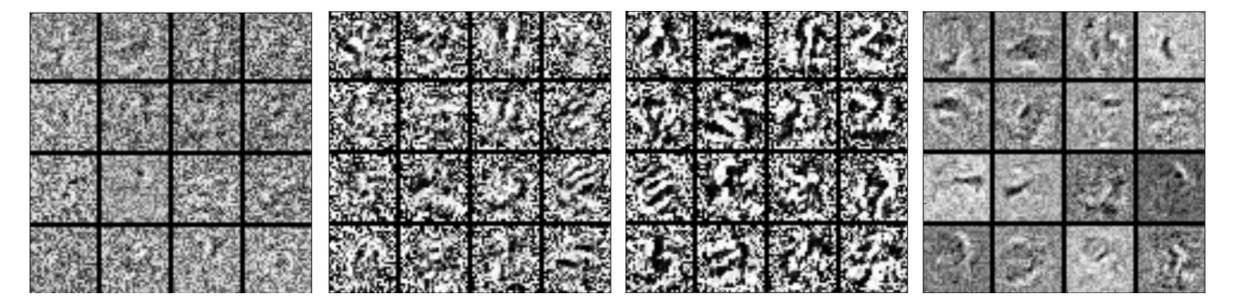
Binary Weights
https://arxiv.org/abs/1511.00363

